Slide 1


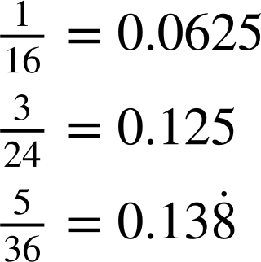
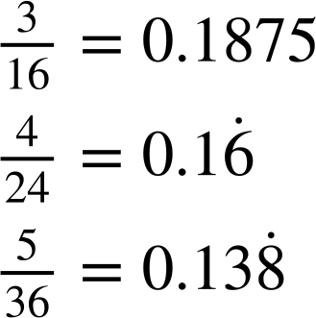
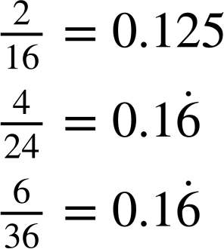
Problem solving with theoretical probability
Task A: Using probability to inform decisions
1) Andeep is playing a game that involves choosing two dice, rolling them and summing their numbers.
Two of the dice are cubes containing numbers 1 to 6
 | 1 | 2 | 3 | 4 | 5 | 6
1 | 2 | 3 | 4 | 5 | 6 | 7
2 | 3 | 4 | 5 | 6 | 7 | 8
3 | 4 | 5 | 6 | 7 | 8 | 9
4 | 5 | 6 | 7 | 8 | 9 | 10
5 | 6 | 7 | 8 | 9 | 10 | 11
6 | 7 | 8 | 9 | 10 | 11 | 12
Two of the dice are tetrahedrons containing numbers 1 to 4
The sample space could be represented with a two-way outcome table.
a) Which combination of dice give the greatest probability of rolling a total of 8?
b) Which combination of dice give the greatest probability of rolling a total of 6?
2 tetrahedrons: P(8) = 1 of each dice: P(8) = 2 cubes: P(8) =
2 tetrahedrons: P(6) = 1 of each dice: P(6) = 2 cubes: P(6) =
2 cube dice
2 tetrahedron dice
c) Which combination of dice give the greatest probability of rolling a total of 7?
d) Write a summary that advises a player how to decide which pair of dice gives them the greatest probability of rolling the total they want.
2 tetrahedrons: P(7) = 1 of each dice: P(7) = 2 cubes: P(7) =
Use two tetrahedral dice when you want to roll a total of 6 or less.
Use two cube dice when you want to roll a total of 7 or more.
either 2 cube dice or 1 of each dice
Alternatively, you could use one of each dice if you want to roll a total of 7.

Slide 2
Problem solving with theoretical probability
Task B: Number of trials required to observe a difference
1) Lucas creates two versions of the same video game: Version A and Version B. In Version A, the probability that a player finds a gem is 0.02 Players are 10% more likely to find a gem in Version B than in Version A.
a) Complete the table.
 | Version A | Version B | difference
probability of finding gem | 0.02
expected gems per 100 turns
expected gems per 1000 turns
0.02 × 1.1 = 0.022
0.022
0.002
0.022 − 0.02 = 0.002
0.02 × 1000 = 20
2
2.2
0.2
0.022 × 1000 = 22
22 − 20 = 2
20
22
2
b) How many turns would it take to expect a difference of 1 gem between the two versions of the game?
0.022x − 0.02x = 1
500 turns
0.002x = 1
expected gems per 1000 turns
expected gems per x turns |  |  | 1
x = 500
20
22
2
÷ 2
÷ 2
÷ 2
÷ 2
Alternatively, proportional reasoning could be used.
10
11
2) Sofia creates a video game where players have a 0.5% probability of getting caught in a trap each turn. She creates a new version of the game where players are now 20% more likely to get caught in a trap each turn, compared to the original version of the game.
a) What is the probability of getting caught in a trap in the new version of the game?
0.5% × 1.2 = 0.6%
b) How many turns would it take to expect a difference of 1 extra trap between the two versions of the game?
0.006x − 0.005x = 1
0.001x = 1
x = 1000
1000 turns
Mathematics in Education and Industry
v2.3

